Slide 1





Sustainability Barometer
2022-11-02
Wisam Orabi Alkhen – Mattias Lindblom – Lovisa Berglund – Clément Lefebvre – Ahmad Setoodeh

Slide 2




Need
Approach
Benefit
Competition
Notes:
This year 7 million acres of forest were burned down due to fires. If we don't do anything right now or in the following years the world is doomed. This is one of the environmental problems right now. Since companies have a big impact on this, Bolagsverket takes this issue very seriously.
We have developed a website using Artificial Intelligence to assess the sustainability of a business. The entrepreneur will be able to take a form containing specific questions, and then he will be presented with educational material (articles links) on ways to be more sustainable.
A big goal would be to implement the solution globally, by doing this it could help companies develop their businesses in a more sustainable way. For bolagsverket this is something that could help to develop partnerships since most companies are aiming to be more sustainable. There are also funds to help companies make the green tranzition .
Today there exist similar solution on the market but these solutions does not help to improve sustainability nether does it use artificial intelligence. Our solution does!

Slide 3
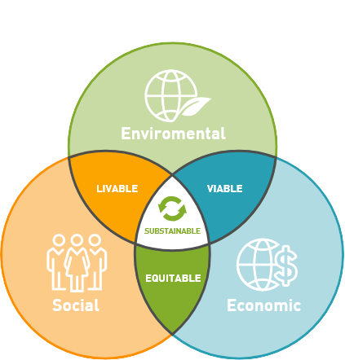



Problem definition
Notes:
//Wisam
-It’s now more important than ever to think about how we can work and live with sustainability in mind.
-The Swedish registration office has the idea that by helping the new entrepreneur to think about sustainability even before the company is created.
-It could help the company to make a large positive impact on the climat in the longer run.
-The idea for helping the new entrepreneur is to create an AI-driven sustainability barometer for companies to test their business idea.
-This tool will help companies reach the United Nations UN’s 17 goals for sustainable develop¨ment.

Slide 4
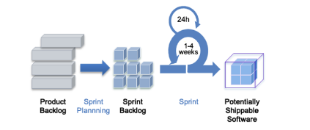
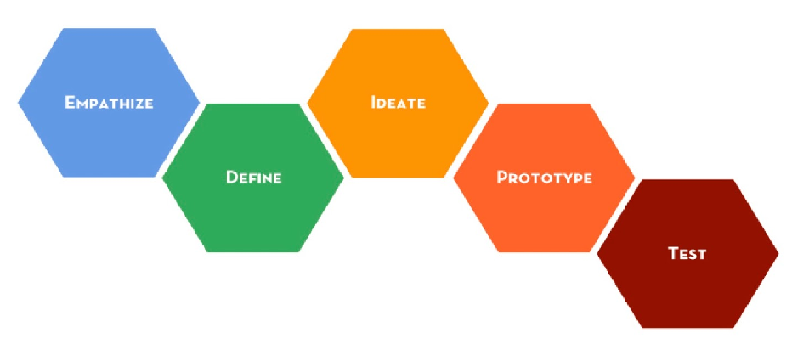
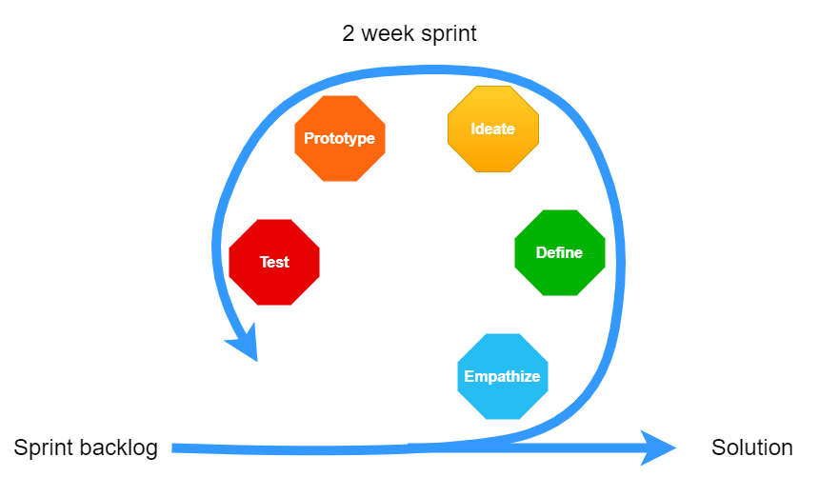
Project methods
Design thinking
Scrum
Work in sprints executed according to the phases
Notes:
//Lovisa .
In this project, the work was structured and conducted using a combination between two agile methods, Scrum and Design Thinking.
The Design Thinking phases were used in order to structure work within the sprints. This created an improvement for each sprint and contributed to an iterative result.

Slide 5

Requirement management
Information from:
Project description
Client meetings
User opinions
Activities
Use case
Impact mapping
User stories
Kano model for prioritization
Product backlog
Notes:
// Lovisa
In order to gather information for the requirement collection three sources were mainly uses. The majority of information were gathered from the project description that were provided in the beginning of the project. But also during meetings with bolagsverket and by taking the intended users opinions into account by investigating what features they would like in a solution such as this one, has helped us to grasp the need. With this information gathered the activities use case, impact mapping, user stories and kano model for prioritizing, could been conducted for finally producing the product backlog.

Slide 6
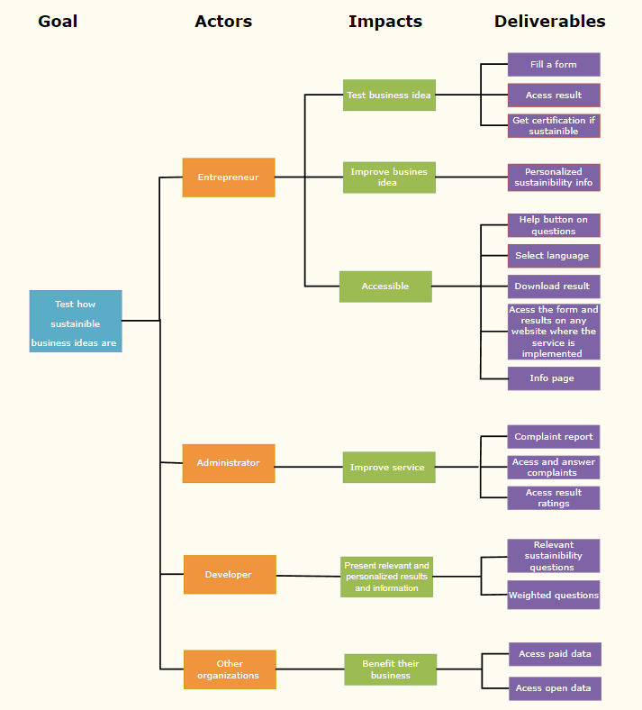
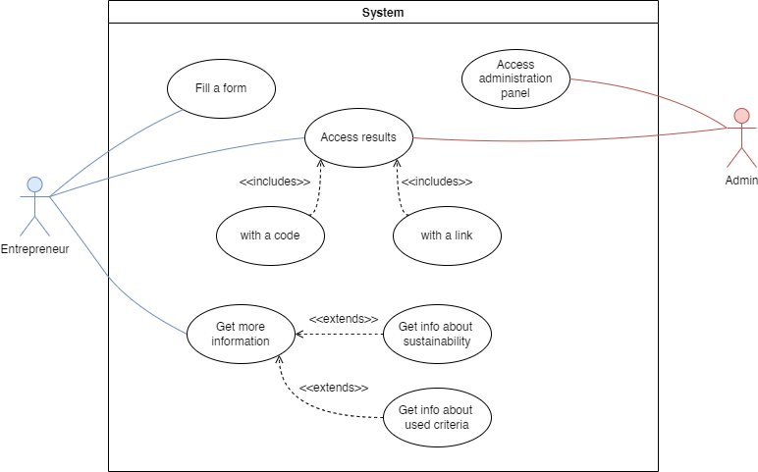
Requirement management
Impact map
Use case diagram
Notes:
Here we can see the use case diagram and the impact map that was created.

Slide 7
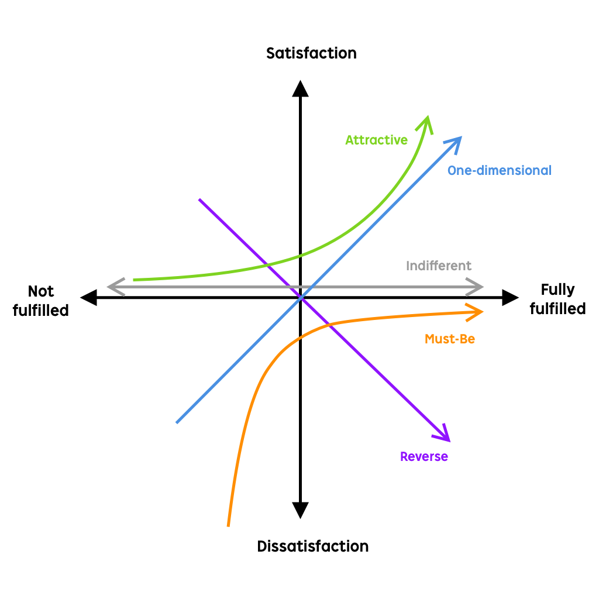
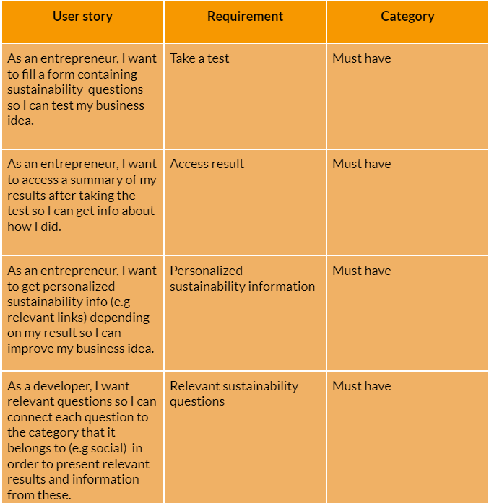
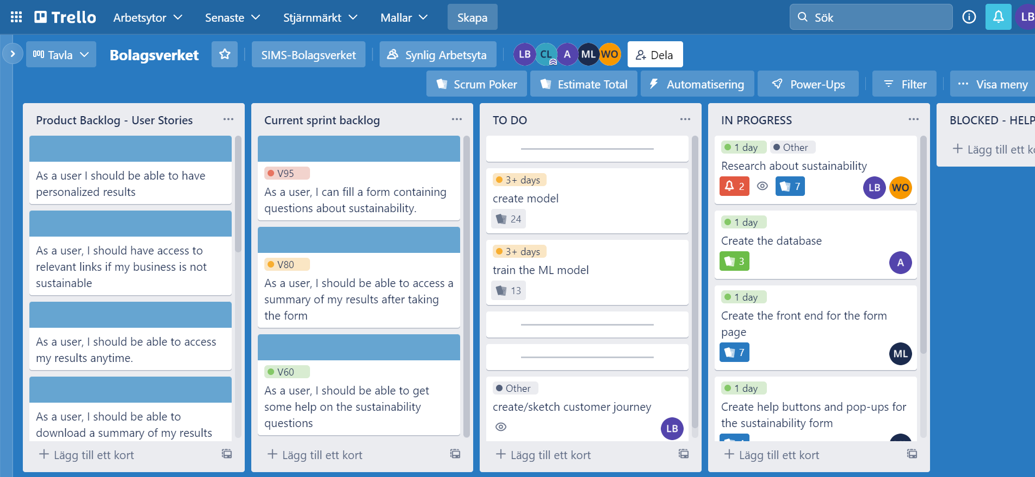
Requirement management
Example from product backlog
Kano model for prioritization
Transferred to sprint backlog in Trello
Notes:
And here we can see an extract of the resulting product backlog and how it looked when it was transferred to trello.

Slide 8
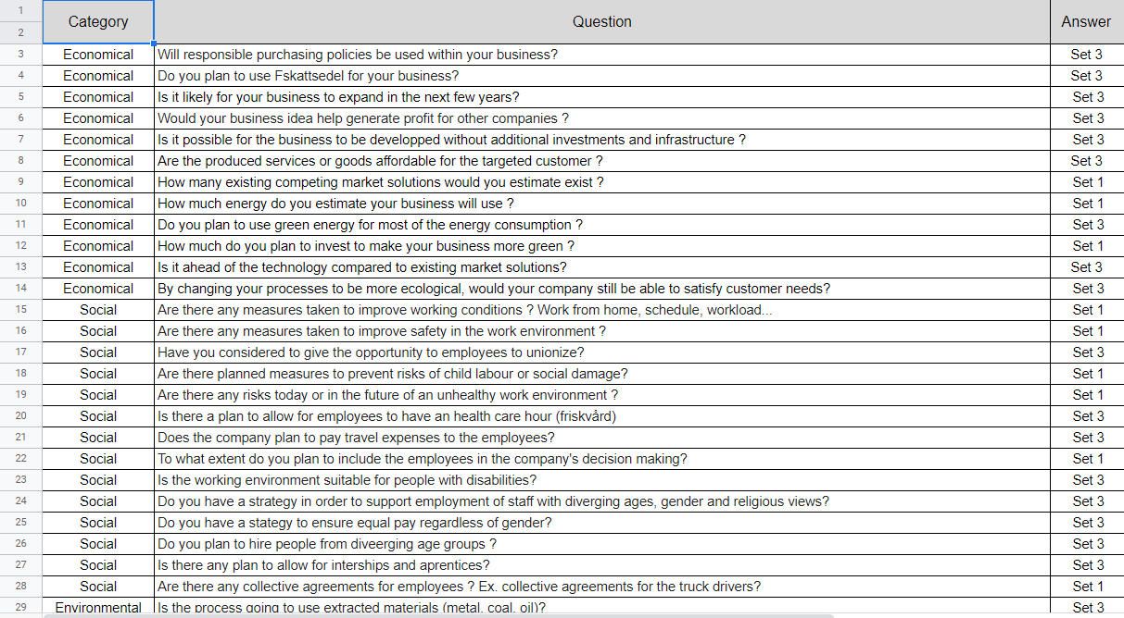
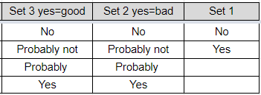
Questions for sustainability
Economical
Social
Environmental
Positive influence
Notes:
//questions
We have come up with around 50 questions about sustainability
each question belong to a category : economical, social, environmental and positive influence
each question is assigned an answer set because not every question can be answered with yes or no

Slide 9
Final solution
ADMIN
SOFTWARE
Web Server
DATABASE
FORM
Computing server
API server
RESULT
AI PROCESSING
API CALLS
Entrepreneur
Notes:
//Clément
when a new entrepreneur wants to assess his sustainability, can fill a form on a website.
form contains questions about his business idea and collects data
API handle communication
AI processes the data and outputs a short analysis and some related articles to improve sustainability
presented in a result page to the user in a web page
Finally, an admin software was developed to manage data in the database : changing questions, accessing analytics about results…

Slide 10

Development methods : Front end
Tools: Vue, Vuex, Vuetify
Result: 4 pages
Notes:
// Mattias
For creating the user interface we decided to go with a javascript library called Vue. Vue is an framework that is used by the developers at bolagsverket and we also decided to go with Vue to make our solution easier to build upon in the future if this service were to be integrated. The front-end resulted in 4 pages.

Slide 11
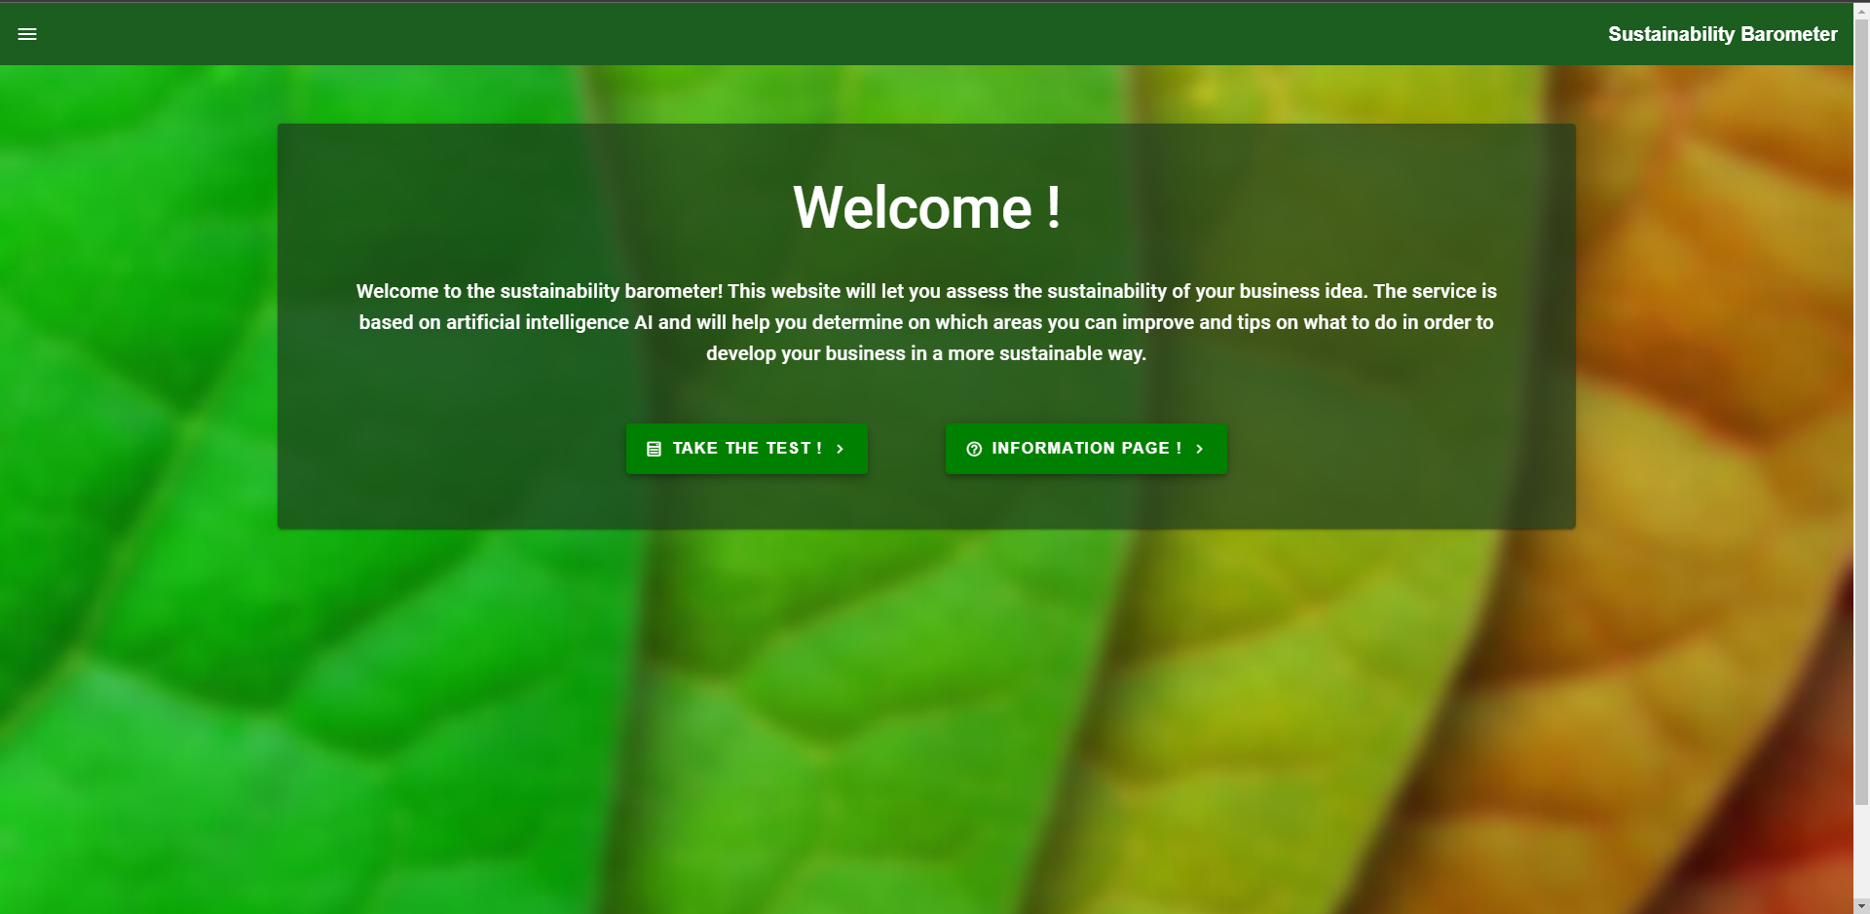
Landing page
Notes:
// Mattias
When the user accesses our service the user will be greeted with this landing page. The main purpose of this service is to take the sustainability test, but we also wanted to provide enough information about the service and sustainability in general and that information is shown in it’s own information page.

Slide 12
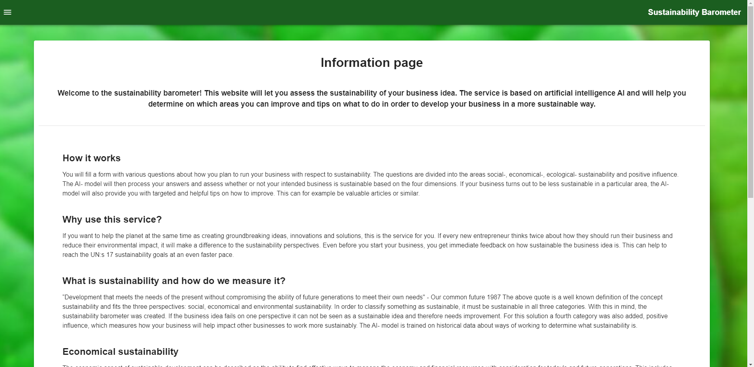
Information Page
Notes:
// Mattias
This is a very simple information page that tries to provide an answers to common questions that the users may have.
Such question could be:
Why should I as an entrepreneur take this test?
How does this service measure sustainability?

Slide 13
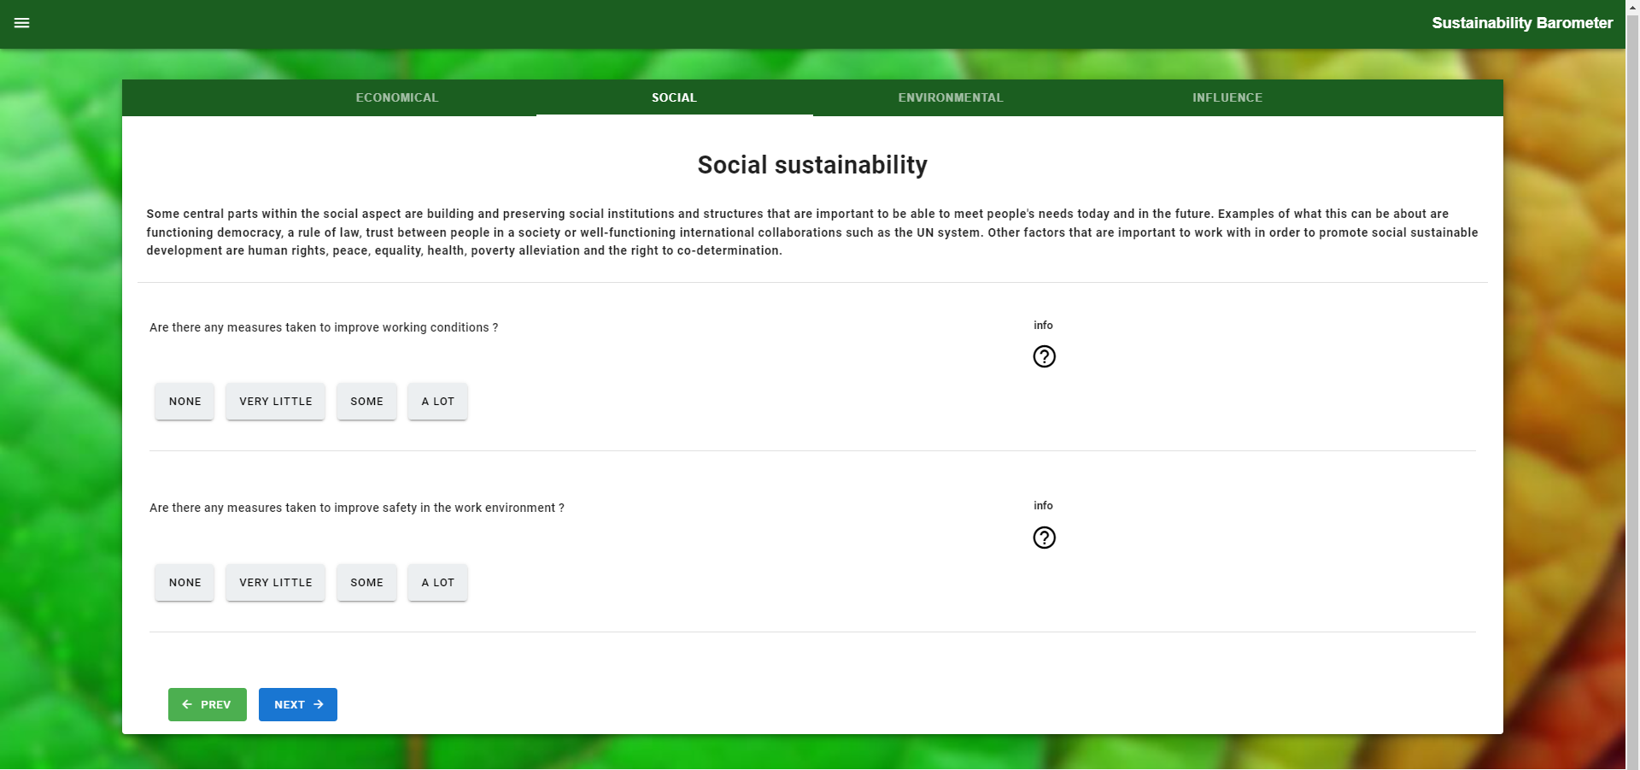
Form Page
Notes:
// Mattias
The sustainability test itself is a form that looks like this. There are 4 categories with questions that the user will answer.
some questions also help text that give some examples that are related to that question.
There is also questions that could be hidden or shown depending on previous answers. This makes it so that if multiple people take this test, it might not look exactly the same for all of them.The purpose of this is to not show too many irrelevant questions for an entrepreneurs business idea.

Slide 14
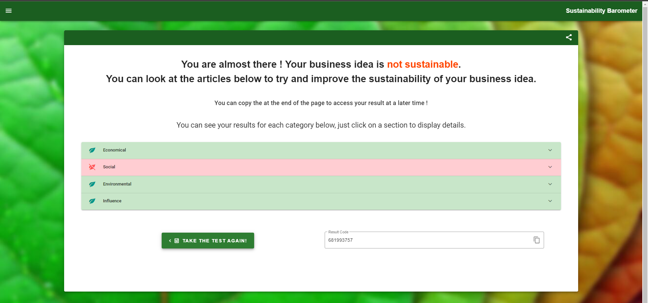
Result Page
Notes:
// Mattias
This is the result page that is shown after the test is done.
At the top it shows the user a summerized result of the test. This result could say that the business idea is sustainably or that there are some improvement to be considered. These tabs will then show if the result was satisfying in this 4 areas or not. A red tab would mean that there are improvements to be made in this category.

Slide 15
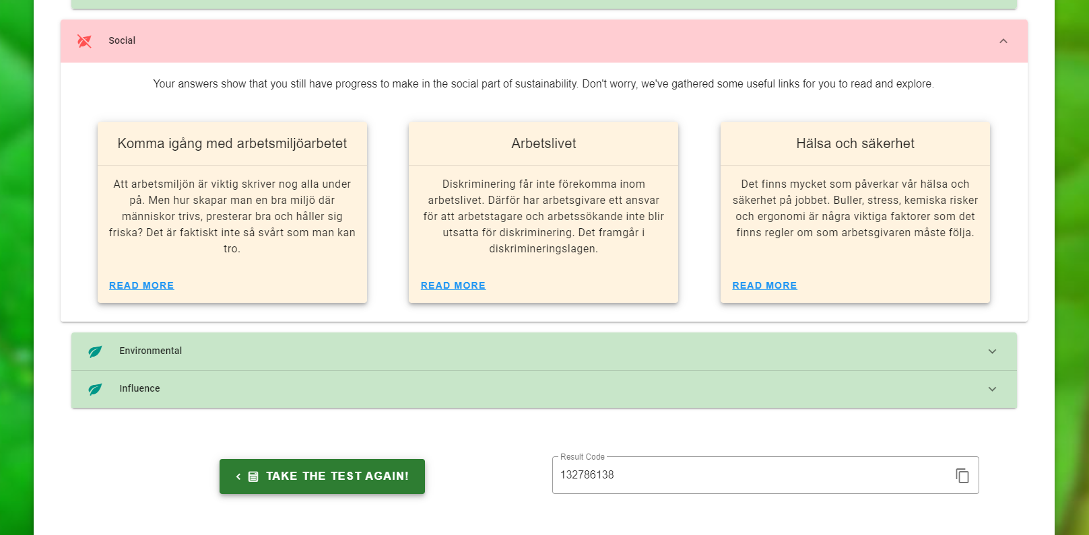
Result page
Notes:
// Mattias
Inside these tabs there will be articles that are related to the users test result. These links will take the user to trusted sources where the user can read more about how to improve in specific areas regarding sustainability.
These Articles are provided with the help of AI technology that will be explained more in a bit.
Lastly since we don’t handle any user information or have a login system, we provide an unique generated code for each result that the user can save in order to access the results at a later time.
So the final thing for me to say about the front end is that most information that is show is stored in the database. And that includes the questions, the articles, and the categories.
This should make it easy to add or remove questions from the test for example through the backend without having to change any front-end code.

Slide 16
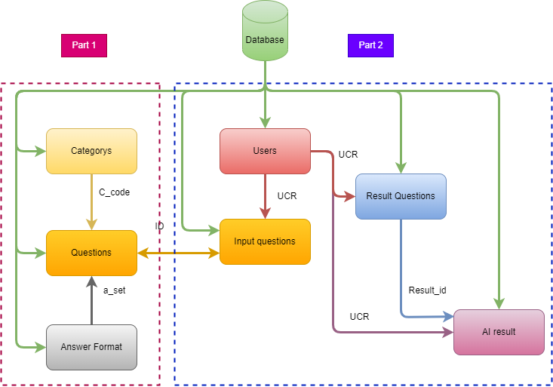
Development methods : Back end and database
Notes:
This is the diagram that show how save and use information from database.

Slide 17
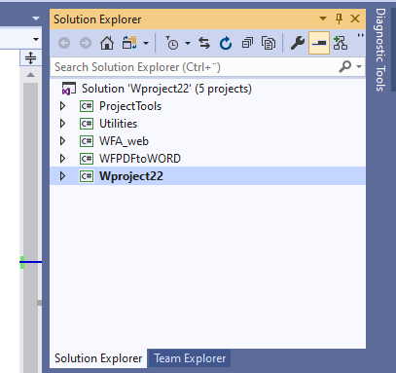
.Net (C#) projects
Notes:
Here is whole projects and sub-project.

Slide 18
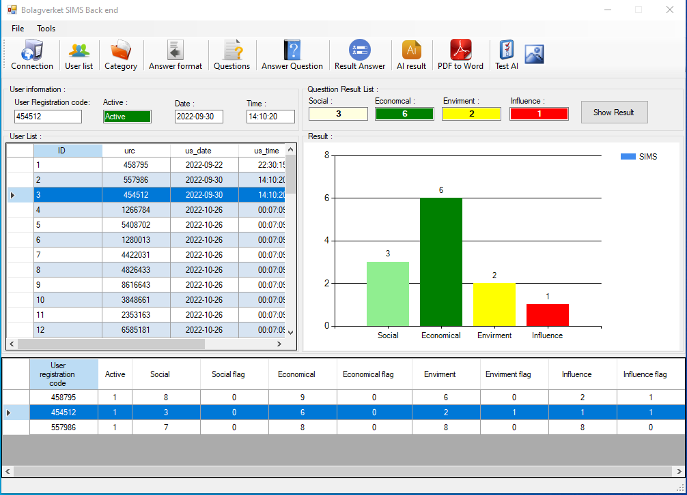
Back end program (Admin)
Main menu
Notes:
Here is main form to display information and choose which form can use for more information like list users,categories,answer format,Question,result question,AI report, PDF convertor, test AI.

Slide 19
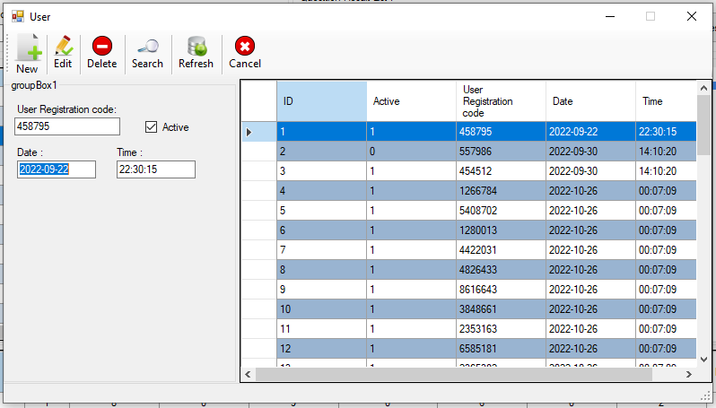
Users form
Notes:
Here show list of users that can add,edit,search. Those option can be for each form to use.

Slide 20
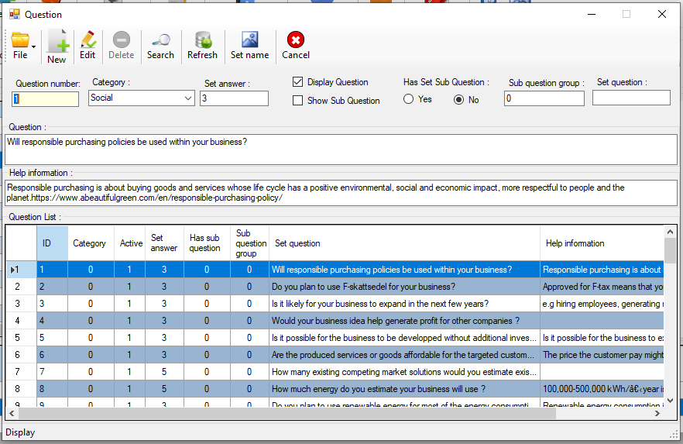
Question form
Notes:
This form show list of question can add,remove,edit, import, export.

Slide 21
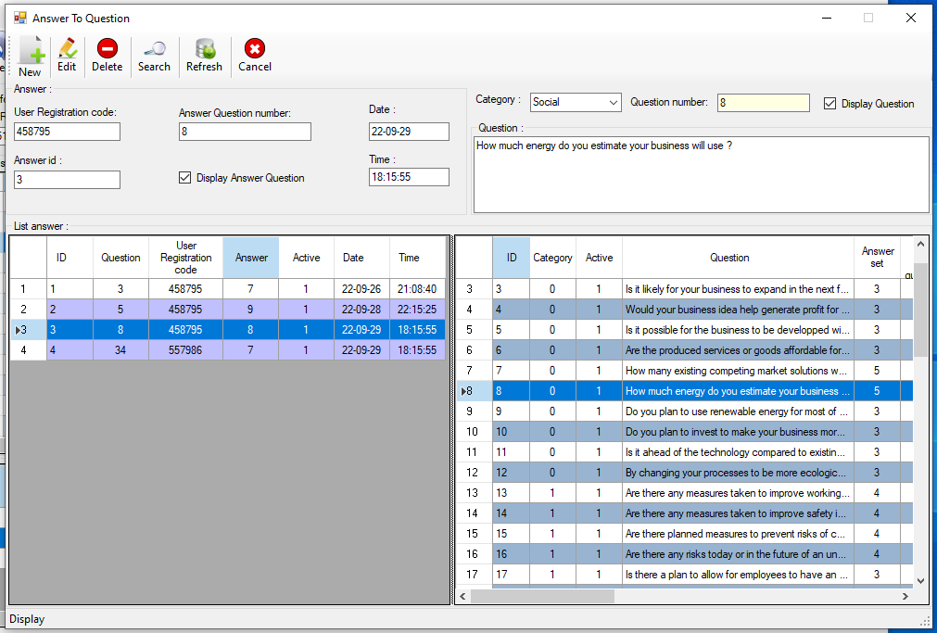
Answer questions form
Notes:
Display Answer question that display for each users.

Slide 22
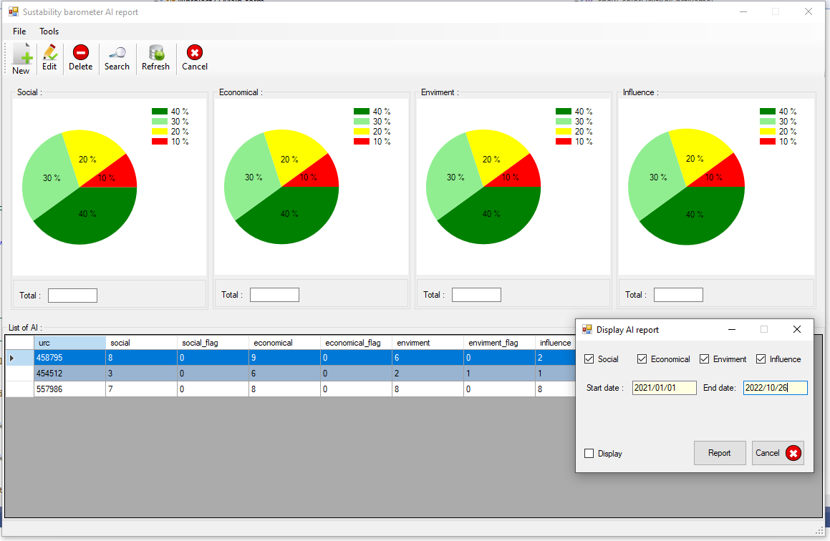
AI report form
Notes:
This form display AI report and have search option for use some period and which category like to show.

Slide 23
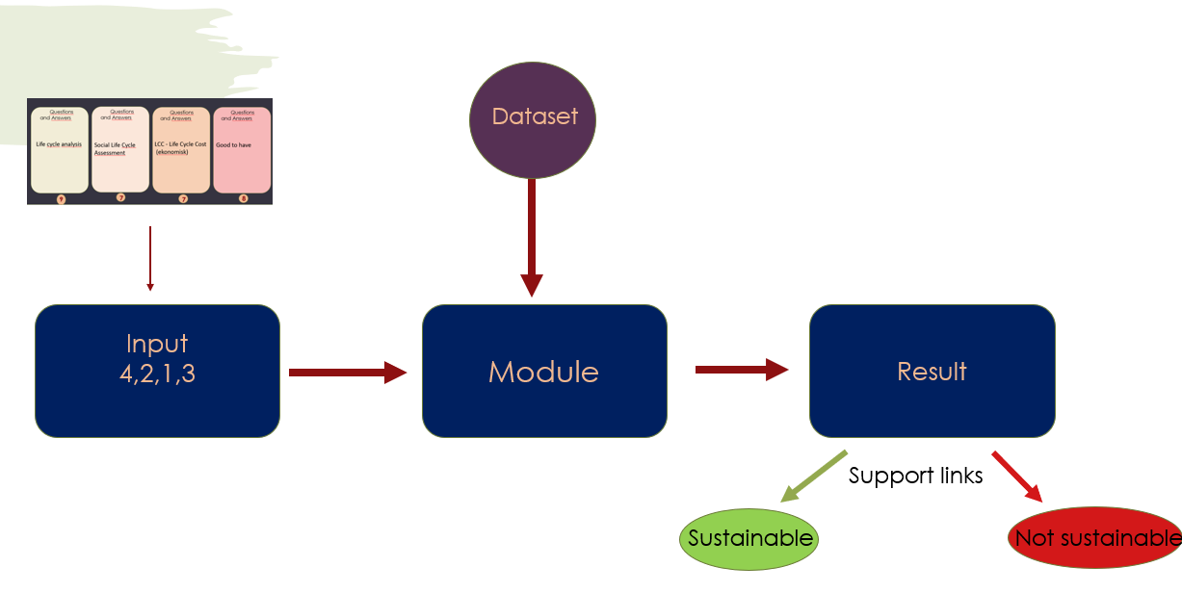
Development methods : Artificial intelligence
Notes:
When the module get the 4 different values ​​from 4 different categories.
We send these values ​​to our module to process these values ​​in an artificial intelligence way to determine whether these values ​​are sustainable or not. In addition, it brings relevant web links to these values ​​and shows them to the user

Slide 24
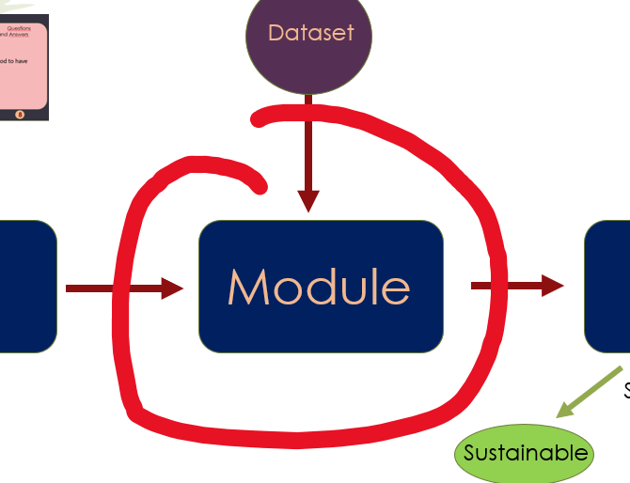
Naive Bayes classifier
Naive bayes statistical algorithm.
Train the module.
Train set.
Test set.
Cross-validation method.
30 % of the data set as a test set.
70 % as a training set.
Iterative way 5 or 10 times.
Notes:
So, how does this unit/module work?
It works by using the naive bayes statistical algorithm which is a classification technique based on Bayes' Theorem with an assumption of independence among predictors.
Where we train the module through advance results from different companies.
and then we give the module new values. The module determines to which class does the this values belongs.
There are several algorithms that can be used in AI to determine the prediction, but I chose the naive bayes algorithm, because it has a high value in the accuracy.
To determine the accuracy, I used cross-validation method, The good thing with this method is that it can be done in iterative way 5 or 10 times, and each time the unit choose a different test and training set than the previous time to make the prediction.

Slide 25
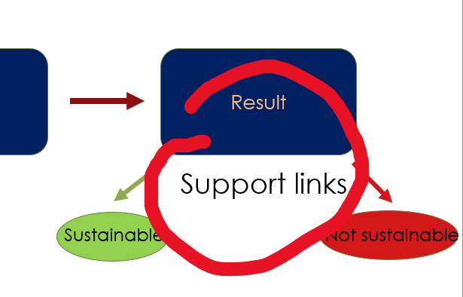
Support links
Fetched new links
Chosen based on research, reports.
provide reliable and useful information.
Fetch links at a specific/certain time.
Notes:
//Wiasm
Instead of writing Hard cod/ ready links into the database, which may not work after one year, I have fetched a new links each time.
Help links will give the user tips to take advantage of in several categories, the links will be chosen and presented based on research, reports, To provide reliable and useful information to the user and to avoid obtaining information from unreliable sources.

Slide 26
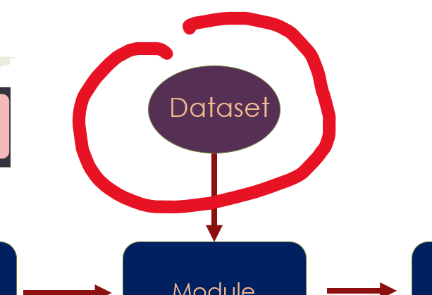
Dataset
The goal is to create the dataset it with real and relevant data.
Notes:
The dataset was created with (fake) data , but our goal was to create it with real and relevant data.
We make a google form with our questions and asked several companies to answer on our questions to generate new dataset that is close to companies’ data to train our unit.
This is the most effective and reliable method.
But we couldn't get answers from the companies because of limitation of the time, so we used the data that I generated.

Slide 27




Development methods : API framework
RESPONSE
REQUEST
FETCH
Notes:
//Clement
instead of going into the bank vault to get your money, you ask the employee to do it, providing a more secure access to information
For this project, we used a php framework called laravel. The choice was made after a bit of research that concluded that it was simple enough and powerful enough for all our needs. The framework used can be exchanged with any other API framework.

Slide 28



Development methods : hosting solution
We used Google Cloud for :
Its ease of use
Its performance
The free tier that allowed us to try for free
Notes:
//Clement
For this project, we didn’t really need a hosting solution because we could have done everything locally. However, with the complexity and interconnection of the different parts of the project, it was best to have everything centralized and accessible to every member of the project.
When we had to choose, we went with google cloud for its ease of use, performance and familiarity for some of the group members.
Google Cloud is a hosting platform that s used by millions of people

Slide 29
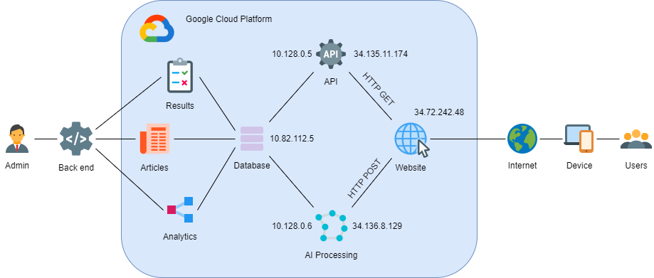
Development methods : hosting solution
Notes:
Every services was finally implemented in google cloud following this diagram

Slide 30
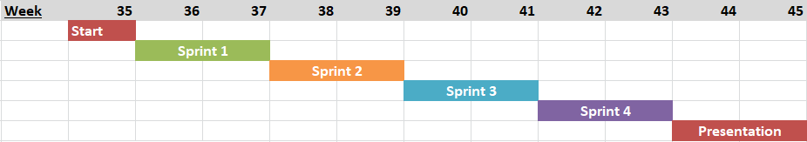
Time schedule
Project Plan
Mockups
Requirements
Front end (headless)
First draft of AI
Questions for the form
Backend and database
Advanced AI
Cloud hosting
API communication
Integration of all the parts together
finishing touches
User tests
Notes:
//Clement
For this project, the time was divided into four different sprints lasting 2 weeks each.
On the last days of each sprint, the work will focus more on preparing for the sprint review meetings rather than completing user stories for the actual sprint.
As you can see, the workflow was good and we didn’t encounter major obstacles.
Sprint 1 : preparation, 2 start development, 3 improving development and integrating services, 4 fixing and testing.

Slide 31
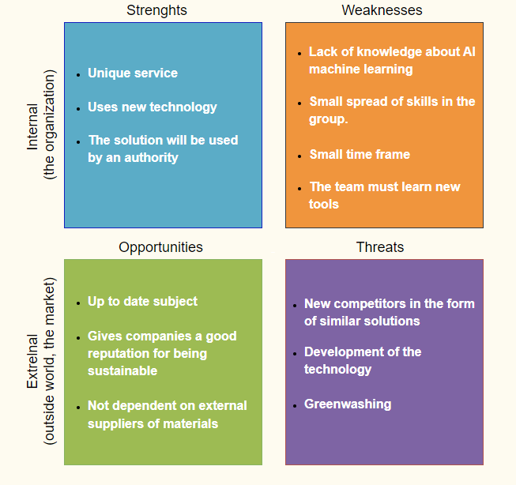
SWOT- analysis
Notes:
Lovisa
The SWOT- analysis of this project gave that one of the biggest strengths this service holds, is that it will be used by an authority which will result in that many people will be exposed to the service and might thereby use it. A weakness for this project has been the small time frame. The biggest opportunity for the sustainability barometer is that it regards an up to date subject. There is a will among people to be more sustainable. The biggest threat of the solution is greenwashing where people only uses the service for marketing themselves when in reality the might not be as sustainable as thy say.

Slide 32
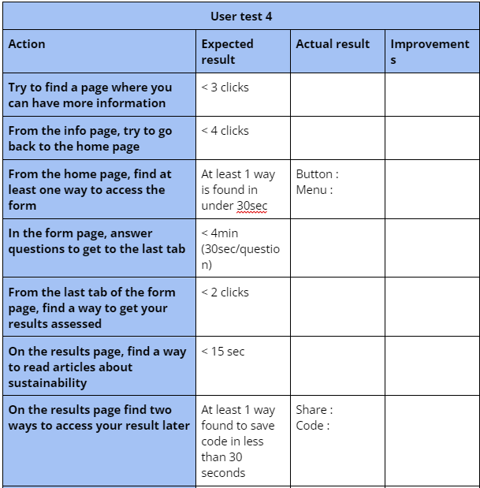
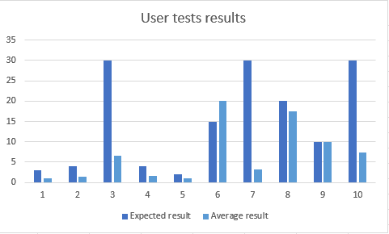
User tests
Notes:
Lovisa
This first table shows an extract of tasks that were tested during the user tests. Expected results for the tasks were defined and actual results were measured. The bar chart shows the expected results and the actual result for task 1-10, where the Y- axis represents the units measured such as clicks and seconds while the x- axis represents the tasks tested from 1-10 . It is noticeable that some expected results values are way higher than the average of the actual values. This is a symbol of a great user interface that made navigation easy for the users.
Apart from these results, the most common needs for improvements the user test showed were more text for buttons in order to show the function of the button. Some buttons were also hard to recognize as buttons.

Slide 33


Current state of the project
Functional :
The form
AI processing
Articles scraping
Display of the results
Help page
API
Accessing the result with a code
Ideas for the future :
Weighted questions
Dataset from real user inputs
Integrating to existing websites (Verksamt, Bolagsverket…)
Rating and complaints system
Adding incentives
Notes:
//Wissam
we managed to get all the main requirements done such as
before shipping the product, we still have to :

Slide 34
Thank you for your attention!
Any questions?
Icons from : https://icons8.com/
Notes:
So that was our project. Thank you for listening to our presentation!
Feedback:
some of the pictures reforce make stronger . Specialle first one and the last one. Slide 2 make stronger.Cleaner and more alike pictures during the whole presentation. Access the graphical profile for bolagsverket. acess througt the intranet. Time for the whole form? Prove that a company started of with using the sustainability barometer. Might be a good idea to tell why AI is a good thing to use in solution such as this. Since we talking about AI as a selling point. We must say we tested different AI models and compared accuracy. How can we develop solution to see if companies are greenwashing. Add page number for seeing progress. We in EU are not allowed to used cloud services for bolagsverket as an authority. Can you move this to internal environment.
talk about the effects of our solution
change pictures for the pitch
images should follow the same graphic design → follow bolagsverket guidelines (template)
mention a range of time it takes to take the test
invest 10min into this and gain a lot
why is AI a good approach compared to the others, which approaches can Bolagsverket take to prevent greenwashing
page numbers
what could have been done differently
journey
make a sprint retrospective

